Slide 1
Sistem Testing Technique
TESTING DAN IMPLEMENTASI SYSTEM
ATA 2008 / 2009
HARJANTO SUTEDJO

Slide 2
Software Testing Strategies
Suatu strategi untuk pengujian S/W yang mengintegrasikan teknik perancangan kasus untuk pengujian S/W untuk barisan langkah pembentukan S/W.
Karakteristik Umum Strategi Pengujian S/W
  Pengujian dimulai pada level modul dan dilanjutkan terus hingga integrasi dari keseluruhan sistem.
  Setiap saat pengujian mengimplementasikan teknik pengujian yang berbeda.
  Pengujian dikelola oleh pengembang S/W dan untuk yang berukuran besar dikelola oleh group penguji yang tidak terikat.
  Pengujian and debugging merupakan aktifitas yang berbeda, tetapi debugging selalu digunakan di setiap strategi pengujian.
HARJANTO SUTEDJO

Slide 3
Validation dan Verification (V&V)
“Validation are we building the product right”
“Verification are we building the right product”
Validation (Product Oriented)
  Validation is concerned with whether the right functions of the program have been properly implemented, and that this function will properly produce the correct output given some input value.
Verification (Process Oriented)
  Verification involves checking to see whether the program conforms to specification. I.e the right tools and methods have been employed. Thus it focuses on process correctness.
HARJANTO SUTEDJO

Slide 4
Testing dari low-level ke high level (Tahapan Testing)
Sistem tidak diujikan sebagai suatu unit tunggal, kecuali untuk program yang kecil.
Systems yang Besar terdiri dari sub-systems, dimana masing2 sub-system terdiri dari modules yang dibentuk oleh procedures and functions.
Proses testing dilakukan dalam beberapa langkah sehingga diproses secara incrementally dalam proses implementasi sistem.
HARJANTO SUTEDJO

Slide 5
Testing Technique
Component testing | Unit Testing | Verification (Process Oriented) | White Box Testing Techniques (Tests that are derived from knowledge of the program’s structure and implementation)
 | Module Testing
Integrated testing | Sub-System Testing
 | System Testing
User testing | Acceptance Testing | Validation (Product Oriented) | Black Box Testing Techniques (Tests are derived from the program specification)
HARJANTO SUTEDJO

Slide 6
Tahapan Proses Pengujian
Unit testing
Module Testing
Sub-system Testing
System Testing
Acceptance Testing
Unit
Testing
Module
Testing
Sub-system
Testing
System
Testing
Acceptance
Testing
User
Testing
Component Testing
Integration Testing
HARJANTO SUTEDJO

Slide 7
Unit Testing
Individual components diujikan untuk meyakini bahwa akan beroperasi secara benar. Setiap komponen diujikan secara terpisah, tanpa komponen sistem yang lainnya
  Code Coverage
  Path Testing
HARJANTO SUTEDJO

Slide 8
Path Testing
Tujuannya meyakinkan bahwa himpunan test case akan menguji setiap path pada suatu program paling sedikit satu kali.
Titik awal untuk path testing adalah suatu program flow graph yang menunjukkan node-node yang menyatakan program decisions (mis.: if-then-else condition) dan busur menyatakan alur kontrol
Statements dengan conditions adalah node-node dalam flow graf.
HARJANTO SUTEDJO

Slide 9
Program flow graphs
Menggambarkan alur kontrol. Setiap cabang ditunjukkan oleh path yg terpisah dan loop ditunjukkan oleh arrows looping kembali ke loop kondisi node.
Digunakan sebagai basis untuk menghitung cyclomatic complexity
Cyclomatic complexity = Jumlah edges – Jumlah Node +2
Cyclomatic complexity menyatakan jumlah test untuk menguji control statements
HARJANTO SUTEDJO

Slide 10
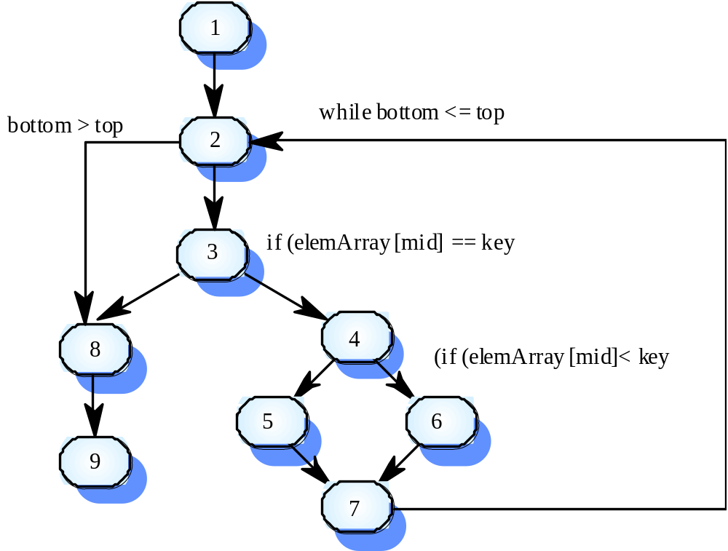
Contoh: Binary Search
HARJANTO SUTEDJO

Slide 11
Path untuk Pengujian Data
1, 2, 3, 8, 9
1, 2, 3, 4, 6, 7, 2
1, 2, 3, 4, 5, 7, 2
1, 2, 3, 4, 6, 7, 2, 8, 9
Test cases harus ditentukan sehingga semua path tsb tereksekusi.
HARJANTO SUTEDJO

Slide 12
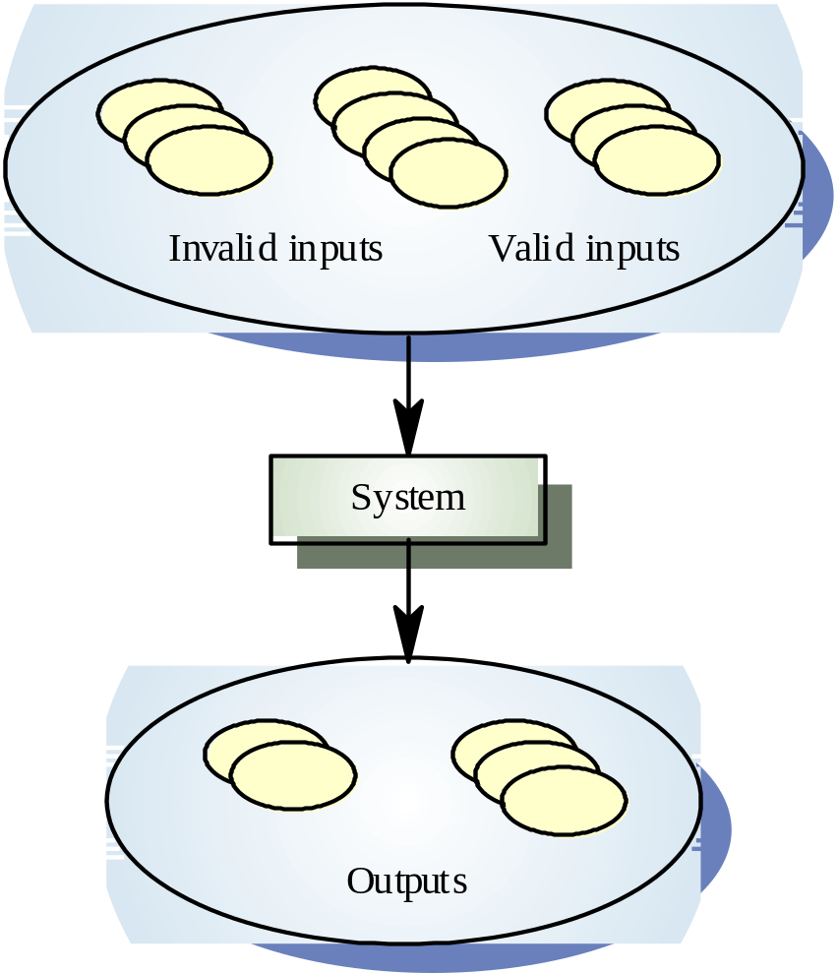
Equivalence Partitioning
Input data of a program is divided into different categories so that test cases can be developed for each category of input data.
The goal is to come out with test cases so that errors are uncovered and test cases can be carried out more efficiently.
HARJANTO SUTEDJO

Slide 13
Module testing
A module is a collection of dependent components such as an object class, an abstract data type or some looser collection of procedures and functions. A module encapsulates related components so it can be tested without other system modules.
HARJANTO SUTEDJO

Slide 14
Sub-system testing: (Integration Testing) (Design Oriented)
Involves testing collections of modules, which have been integrated into sub-systems.
Most common problems, which arise in large software systems, are sub-systems interface mismatches.
Concentrate on the detection of interface errors by rigorously exercising these interfaces.
HARJANTO SUTEDJO

Slide 15
Integration Testing
Top-down testing
  Berawal dari level-atas system dan terintegrasi dengan mengganti masing-masing komponen secara top-down dengan suatu stub (program pendek yg mengenerate input ke sub-system yg diuji).
Bottom-up testing
  Integrasi components di level hingga sistem lengkap sudah teruji.
Pada prakteknya, kebanyakan test integrasi menggunakan kombinasi kedua strategi pengujian tsb.
HARJANTO SUTEDJO

Slide 16
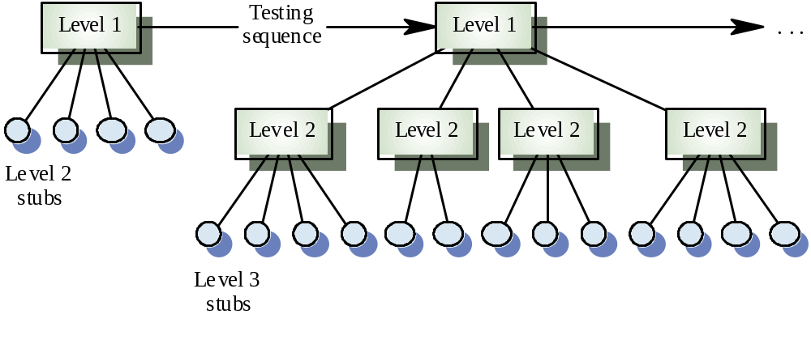
Top Down Testing
HARJANTO SUTEDJO

Slide 17
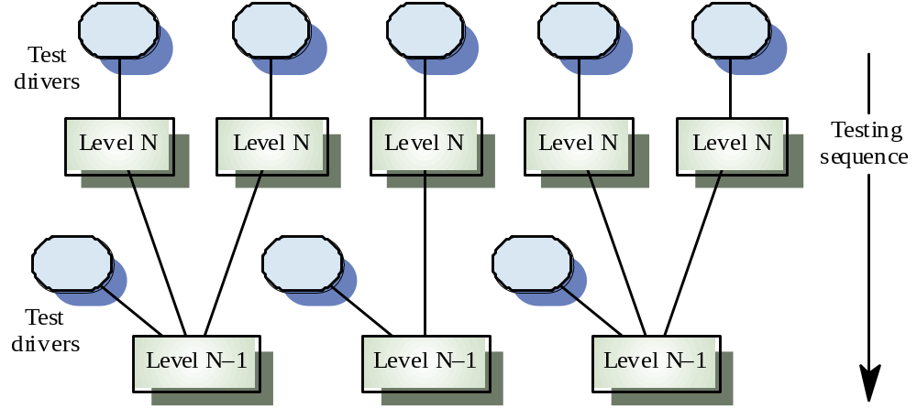
Bottom Up Testing
HARJANTO SUTEDJO

Slide 18
System testing
The sub-systems are integrated to make up the entire system.
Concerned with finding errors that result from unanticipated interactions between sub-systems and system components.
Concerned with validating that the system meets its functional and non-functional requirements.
HARJANTO SUTEDJO

Slide 19
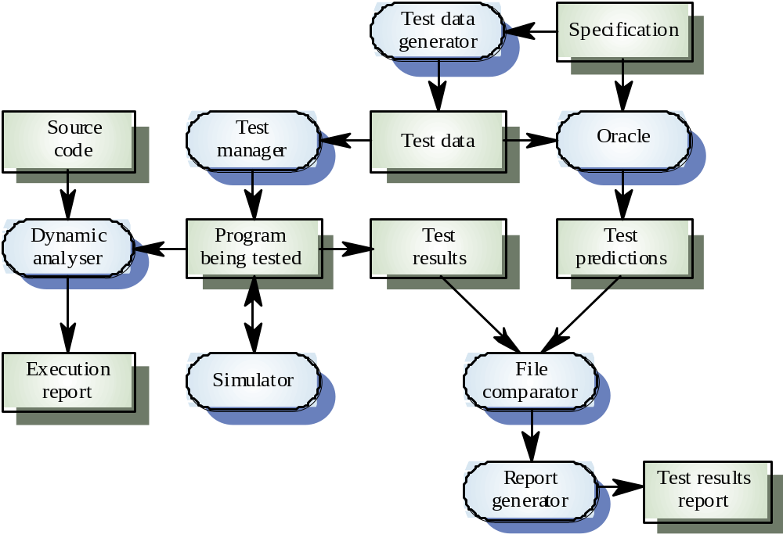
Testing Workbench
HARJANTO SUTEDJO

Slide 20
Object-oriented testing
Components yang diuji adalah class object yang diinstantiate ke object.
Lebih besar dibandingkan pengujian sebuah function sehingga pendekatan white-box testing perlu diperluas.
Tidak jelasnya ‘top’ suatu system untuk top-down integration dan testing
HARJANTO SUTEDJO

Slide 21
Testing levels
Testing operations pada objects
Testing object classes
Testing clusters cooperating objects
Testing OO system secara lengkap
HARJANTO SUTEDJO

Slide 22
Object class testing
Complete test yang menguji class melibatkan
  Testing semua operations suatu object
  Setting dan interrogating semua attribute object
  Menguji object untuk semua state(keadaan) yg mungkin
Inheritance akan mengakibatkan sulitnya perancangan object class tests seperti information yg diuji sulit dilokalisasi.
HARJANTO SUTEDJO

Slide 23
Acceptance testing
Final stage in the testing process before the system is accepted for operational use.
Test with data supplied by the system client rather than simulated test data.
May reveal errors and omissions in the systems requirements definition( user – oriented) because real data exercises the system in different ways from the test data.
May reveal requirement problems where the system facilities do not really meet the users needs (functional) or the system performance (non-functional) is unacceptable.
HARJANTO SUTEDJO

Slide 24
Acceptance Test (2)
Sometimes called alpha testing. The alpha testing process continues until the system developer and the client agrees that the delivered system is an acceptable implementation of the system requirements.
When a system is to be marketed as a software product, a testing process called beta testing is often used.
Beta testing involves delivering a system to a number of potential customers who agree to use that system.
HARJANTO SUTEDJO

Slide 25
Testing Server Applications
There are several kinds of situations which the scripts may be designed to invoke during server tests:
  Volume Testing
  Stress Testing
  Performance Testing
  Recovery Testing.
HARJANTO SUTEDJO

Slide 26
Volume Testing
Finding weaknesses in the system with respect to its handling of large amounts of data during short time periods.
For example, this kind of testing ensures that the system will process data across physical and logical boundaries such as across servers and across disk partitions on one server
HARJANTO SUTEDJO

Slide 27
Stress Testing
Showing that the system has the capacity to handle large numbers of processing transactions during peak periods.
An example:
  of a peak period is when everyone is logging back onto an on-line system after it has been down.
  In a batch environment a similar situation would exist when numerous jobs are fired up after down time.
HARJANTO SUTEDJO

Slide 28
Performance Testing
Can be accomplished in parallel with Volume and Stress testing because you want to assess performance under all load conditions.
Generally assessed in terms of response times and throughput rates under differing processing and configuration conditions.
If the tester can identify any business processing cycles (e.g. month-end, Quarter-end, Semi-annual, and annual) the system performance should be tested under emulations of each processing cycle.
HARJANTO SUTEDJO

Slide 29
Performance Testing (2)
Should cover performance under all hardware and software system configurations.
Client Server system test performance under corporate and field environments (Laptops v. desktops, LAN v. WAN),
Test the system in conjunction with a second system utilizing the same server and at times accessing the same database. These are circumstances which can severely impact performance in networked C-S systems.
HARJANTO SUTEDJO

Slide 30
Performance Testing
Client-centric approach to Client-Server load management,
Configuration of server -> Look at cache settings, disk I/O, and network cards first, then at the interaction between the application and the network
How much application logic should be remotely executed, how much updating should be done to the server database over the network from the client workstation, and how much data should be sent each in each transaction -> Look at all of the processes running on the machine and all of the resources each process receives.
HARJANTO SUTEDJO

Slide 31
Data Recovery Testing
Data recovery and system restart capabilities can save a lot of money and time which could be lost when a production system fails.
Recovery testing is even more important because data stored on networked servers can be configured in many different ways.
There are several different levels of Redundant Array of Inexpensive Disks (RAID) technology which is a framework for spreading data across several database or file servers and assuring data recovery if one of the servers fails.
HARJANTO SUTEDJO

Slide 32
Data Recovery
data loss can happen when hard disk subsystem failures occur, when system software fails, through accidental or malicious deletion, Destructive viruses, natural disasters, and theft.
important to test all of the recovery options for your RAID system while monitoring system performance.
HARJANTO SUTEDJO

Slide 33
Server Recovery
server recovery testing should include testing recovery from the four types of errors:
  GPPE errors occur when an invalid processor operation is attempted
  IOPE errors occur when the server encounters an invalid execution path
  NMI errors are hardware generated errors usually resulting from power fluctuations or RAM failure.
  Break Points occur when the stack is corrupted resulting in an invalid return point, or when a function pointer reference an invalid code location.
HARJANTO SUTEDJO

Slide 34
Data Backup and Restore Testing
All data base and file servers should have defined backup procedures and defined restore procedures -> should be tested
Test the backup strategy plan is key to avoiding data loss:
  1. How often should the backups be done?
  2. What is the backup medium (cartridge, disk)
  3. When will the backups be done?
  4. Will the backups be manual or automated?
  5. How will it be verified that the backups occur without errors
HARJANTO SUTEDJO

Slide 35
Data Back-Up and Restrore Testing
  6. How long will backups be saved?
  7. Where will the Backups be saved?
  8. How long will it take to restore the last backup?
  9. Who is responsible for assuring that backups are done?
  10. Who is responsible to do backups and restores if the primary person is not available
Test periodically the procedures for dumping the database to the backup server, loading the transaction log to the backup server, and for bring the backup server on-line if the primary server goes down.
HARJANTO SUTEDJO

Slide 36
Data Security Testing
Test the controlled access to third party tools.
Test the stored procedures to control access to specific database tables.
Test the use of encrypted passwords/data transmission
Test the use shadow user names for users that have right of write and read.
HARJANTO SUTEDJO

Slide 37
Automated Server Testing Tools.
Stored procedures and data base triggers are best tested using driver modules which directly access the database layer
LoadRunner/XL which is an automated testing tool that test the server side of multi-user Client-Server applications for capacity planning and for identifying the best server configuration for database performance.
HARJANTO SUTEDJO

Slide 38
Automated Server Testing Tools.
Blue Lagoon Software which offers tools for testing the link between the client and the server
Mercury/Blue Lagoon Software also offer SQL Profiler which Stores and displays statistics about SQL commands embedded in C-S applications.
Microsoft's SQLEYE is an NT-based tool which can be used to track the information be passed between SQL Server and its clients
Software testing tools for unit testing
HARJANTO SUTEDJO

Slide 39
Network Security Testing
Test the network parameters and configurations (firewall, web server, mail server, etc)
Test the network media transmission,
Test the connections for WAN/MAN/LAN,
Test the network provider performance,
HARJANTO SUTEDJO

